Slide 1
Data Analytics
Arcot (Raja) Rajasekar
rajasekar@unc.edu
Unit #01

Slide 2
Unit #01
Introduction to Data Analytics

Slide 3
Course Goals
Learn about Information Analytics
  Data to Information
    Syntax to Semantics
  Information to Knowledge
    Semantics to Pragmatics
  Knowledge to Action
    Pragmatics to Semiotics

Slide 4
Data Analytics
Apply processes, tools and technologies to turn, through conscious, methodological approaches, data (from any and all sources) into information, information into knowledge, and knowledge into actions towards achieving higher ‘fitness’ results.
a mashup definition from Biere and tdwi.org

Slide 5

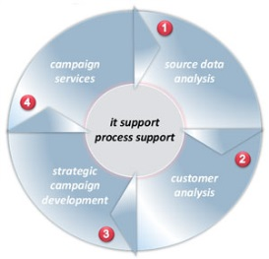
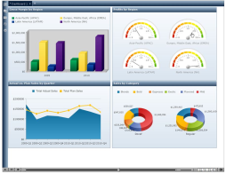

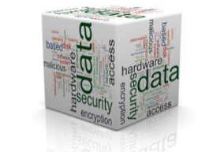
What is Data Analytics?
Data Analytics helps organizations and users to make intelligent, fact-based decisions or find patterns that are hidden in data
Steps in the process:
Gather
Data
Prepare
Data
Analyze
Data
View & Interpret
Data
Derive & Act
Surveys, Sensors,
Web, Internet of Things
Databases, Data Warehouse,s Networks, Clusters
Statistics, Decision Making, Data Mining,
Describe, Relate, Explore, Predict
Convert to Knowledge and act on it

Slide 6
It helps Answers Key Questions
What movies (or books) customers would like to watch (or read)?
What movies to order from studio and how many?
Who are our best customers?
When is there a flu epidemic in region in the country?
Which customers are most likely not to have an accident?
When a customer is likely to jump ship & go to a competitor?
When should we tell a customer to quit gambling?
What is the one item you want to have in your store in case of a hurricane?
What is the best criteria that predicts success when hiring a new Ph.D. student to become a faculty member?
What is the one thing that will improve a lawyer’s chance to win a case?
What are some questions one can answer with a loyalty card?
What is the number one reason for the success of baseball player?
Why should you always defer to the 2nd half to get the ball in college football?

Slide 7
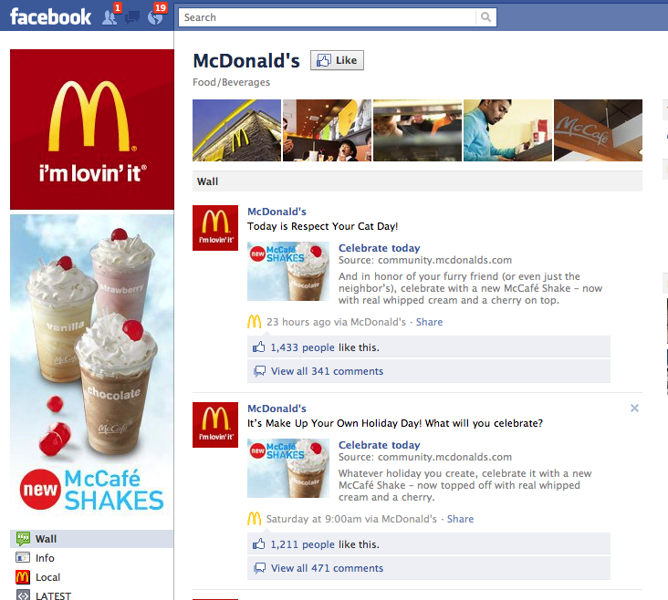
Slide adopted from Business Intelligence, Matt Schwartz, March 31, 2011

Slide 8
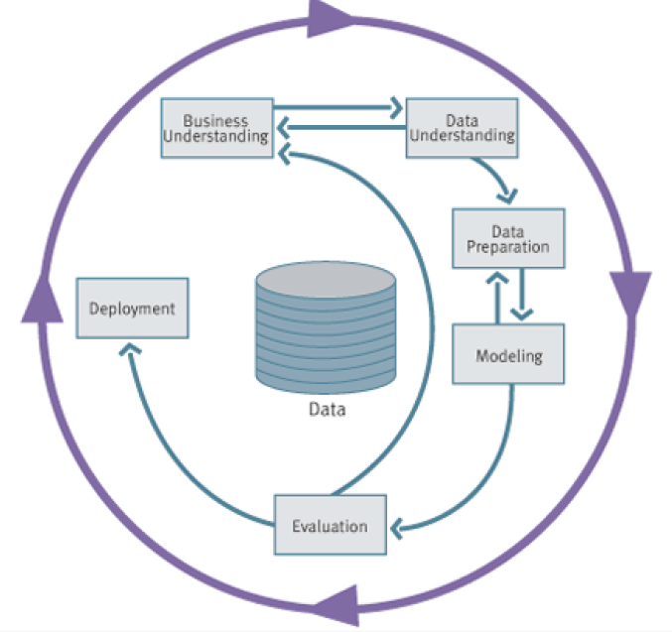
CRISP-DM Process
* Cross-Industry Standard Process for Data Mining (Shearer, 2000)
Image from “Data Science for Business”, Provost and Fawcett, 2013

Slide 9
Dangers in Analytics
Privacy
Security
Drawing decisions on incomplete data
Drawing decisions on inaccurate data
Using only data that supports our gut decisions - bias
Drawing the wrong conclusion from the data
  Stock prices example

Slide 10
Data for Information Analytics
Four Types Data:
Categorical (nominal) data
Ordinal data
Interval data
Ratio data

Slide 11
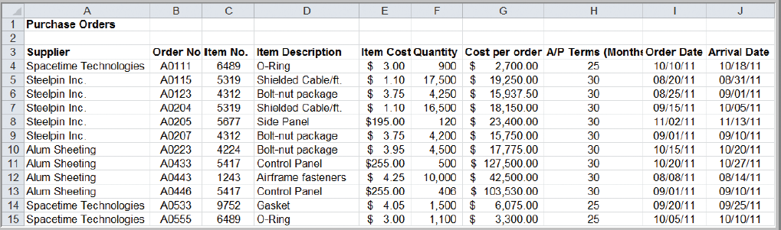
Classifying Data Elements in a Purchasing Database
Figure 1.2
Ratio & ordinal
Ratio
Ratio
Ordinal
Interval
Interval
Categorical
Categorical
Categorical
Categorical
Copyright © 2013 Pearson Education, Inc. publishing as Prentice Hall
From: Business Analytics: Methods, Models, and Decisions,
1st edition James R. Evans

Slide 12
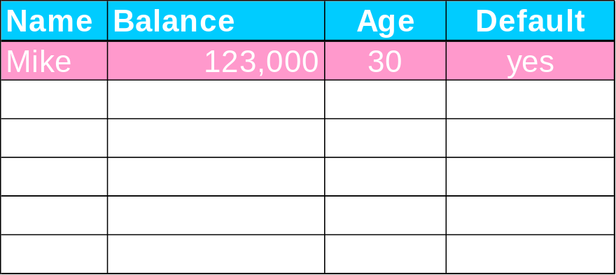
Dimensionality of the data?
Attributes/Features
“Dimensionality” of a dataset is the sum of the number of numeric features plus the number of values of categorical features
Basically the domain space of values that are possible…

Slide 13
Patterns, Models & Data Mining
A pattern is consistent trait or feature found in the dataset – i.e., every sample is consistent with the trait.
  College students are over 18 years old
  Tigers are yellow with black stripes
  Infants are susceptible to flu
  Consumers who are above 40 and earning more than $50K pay back their loans
A model is a pattern that is consistent beyond the current dataset – stands the test of time; it is a simplified representation of reality
  Patterns that can hold beyond the current sample set.
Data mining is the process of discovering patterns from existing data and moving towards a model of reality

Slide 14
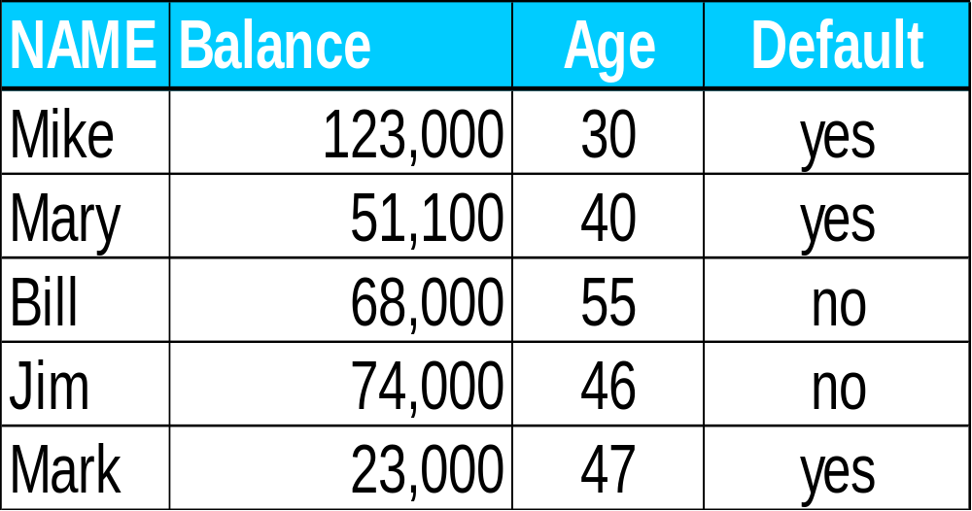
Model = Classifier? Probability Estimation? Ranking?
Pattern 1:
If Names starts with M
Then Buy = ‘yes’
Else Buy = ‘no’
Pattern 2:
Young people are more likely
to buy
Pattern 3:
If Balance >= 50K and Age > 45
Then Buy = ‘no’
Else Buy = ‘yes’
Pattern 4:
If AGE >= 45
Then p(Buy=Yes) = 0.25
Else p(Buy=No) = 0.75

Slide 15
Classification? Probability Estimation? Ranking?
Pattern 1:
If Names starts with M
Then Buy = ‘yes’
Else Buy = ‘no’
Not even a model
Pattern 2:
Young people are more likely
to buy
Ranking Model
Pattern 3:
If Balance >= 50K and Age > 45
Then Buy = ‘no’
Else Buy= ‘yes’
Pattern 4:
If AGE >= 45
Then p(Buy) = 0.25
Else p(Buy) = 0.751
Classifier Model
Probability Estimation

Slide 16
Important Takeaways: Pattern vs. Model
Not all patterns are models.
Model is a pattern which holds beyond the training set and is “universal” for that problem.
There can be more than one model and more than one type for a given set of data
Finding an appropriate Model and Applying is key to Information Analytics
Prepare
Data
Analyze
Data
View & Interpret
Data
Derive & Act
Databases, Data Warehouse,s Networks, Clusters
Statistics, Decision Making, Data Mining,
Describe, Relate, Explore, Predict
Convert to Knowledge and act on it

Slide 17
Types of Data Analytics
Descriptive Analytics
  know what happened and find why it happened
  post-mortem analysis
Predictive analytics
  use past to predict the future
  Predict likelyhood of some event occurring
Prescriptive analytics
  what if scenarios
  Suggest course of actions

Slide 18
Types of PA (Target)
Classification: For each individual in a population, identify a class (or a set of classes) to which that individual belongs.
  Loan default or loan payback
Class probability estimation: Find the probability/score that the individual belongs to each of the classes?
  Probability of being in either class
Regression: For each individual in a population, estimate the numerical value for the target variable
  find how much can they payback

Slide 19
Types of PA (Grouping)
Similarity matching: identify similar individuals based on known features.
  Person A will behave similar to person B
Clustering: group individuals together by their similarity - no target variable!!
  Cluster based on some functionality
Co-occurrence Grouping (association rule discovery, or market-basket analysis): find associations between entities based on the “transactions” they are part of.
  Bread & butter are bought together 70% of the time

Slide 20
Types of PA (linking)
Profiling: characterize the behavior of an individual, group, or population.
Link Prediction: predict linkages/connections between individuals – strength of the link.
  Friend’s linkages
Data Reduction: abstract or distill a large set of data into a smaller set.
  Average , Median, Min, Max ….
  Wall street

Slide 21
Supervised vs. Unsupervised Learning
Key Questions:
  Is there a specific target variable?
  (Are data on this target variable available?)
Supervised |  | Unsupervised
Classification | Data reduction | Clustering
Regression | Similarity matching | Co-occurrence grouping

Slide 22
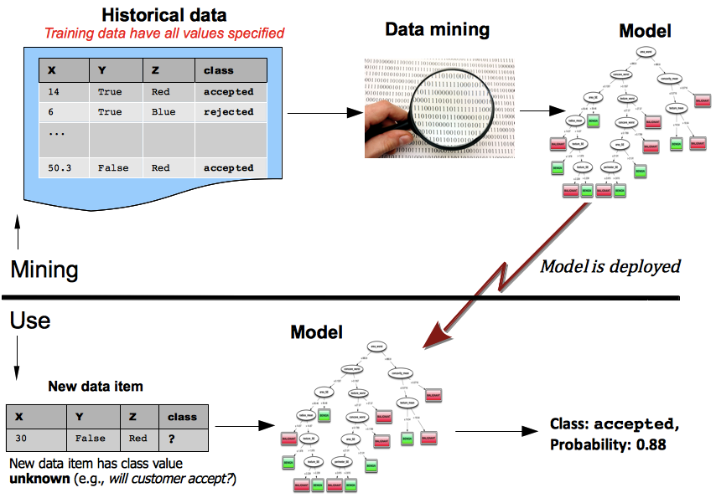
Predictive Analysis Model
(training)
Image from “Data Science for Business”, Provost and Fawcett, 2013

Slide 23
Keys to Predictive Analytics
Key (part 1): is there a specific, quantifiable target that we are interested in or trying to predict?
Key (part 2): do we have data on this target??
Key (part 3): the result of supervised predictive modeling is a MODEL that given data predicts the target

Slide 24
A Simple Example: Supervised Modeling
Scenario: Insurance Company
Problem: Predict the sale of a new insurance product.
Find: Customer Profile: Who will buy this new product?
Dilemma: We cannot try to target everyone with advertisement. Cost can be prohibitive
What is our TARGET?
What DATA is needed to predict success?
Target Variable: Customer who buys or not?
Get Data: Target a small set of customers
Model: Use data to find customer profile.

Slide 25
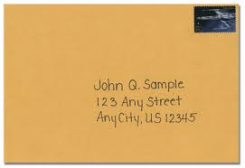
Learning Phase: Market Life Insurance
Market to a small audience
Send a letter to some prospects in a mailing list
Wait for a response …
Age | Income | Response?
35 | 75K | no
68 | 83K | yes
43 | 61K | no
71 | 56K | yes
… | … | …
Data: Used for modeling

Slide 26
Eyeball Analysis: Targeting New Life Insurance product
Data: Divided to isolate groups
Model: Classification tree
Split over income
Income
Age
<50K
>=50K
NO
Age
45
Split over age
<45
>=45
?
NO
NO
YES
Data: Mining Phase
50K
Model: Use Phase
Income
Did not buy life insurance
Bought life insurance
New Target: Interested in LI?

